Slide 1

Bear Rides
Andrew Scouten
Asher Snavely
Leyao Yang
Xiangan Wan
Yunzhe Liu

Slide 2
Chinese students
Cars?
Uber?
Efficient?

Slide 3
One Perfect Use Case

Slide 4
Log in
Primary Actor: Driver & Passenger
Stakeholders and Interest:
Driver: Wants fast log in and post plans for the services or update personal profile.
Passenger: Wants fast log in and post request or select interested trips or update personal profile.
Administrator: Wants to be able to create, modify or delete accounts.
PreConditions: User needs to be a Baylor student.
PostConditions: User is aware of the log in time.
Main Success Scenario:
User opens the software.
User sees that the software offers two options for the user: log in or register.
User click on the “Log in” button.
User enter user name and password.
User can click “Remember me” to remember the name and password.
User navigates through the software and finds things to update.
User posts trips or requests.
User clicks “submit” for any posts or changes.
User logs out of the account.
User closes the software.
Extensions:
At any time, the system fails: 1.Driver logs out of his/her account, and refresh the website. 2. Send an email immediately to the support email provided at the bottom of the website.
Unable to log in: 1.Check internet connection. 2. Refresh the page or reopen the software.
Wrong User name or Password: 1. Insert your user name or password again. 2. Click “see password” to make sure what you inserted is what you expect to be. 3. Click reset password, then a email will be sent to you with a link to reset your password.
Unable to pass the verification/Did not get the email: 1. Check if all the information provided is accurate. 2. Make sure the email address is correct, sometimes people misspell Baylor or forgot to add a “1” to the end of their names.
Unable to submit: 1. Check every required to fill columns are filled. 2.Check if there is any not allowed characters included in the information you filled.
Cannot open the software: 1. Check if the correct and updated version of the software is downloaded. 2. Check if you download iOS version for a window.

Slide 5
System Sequence Diagram

Slide 6
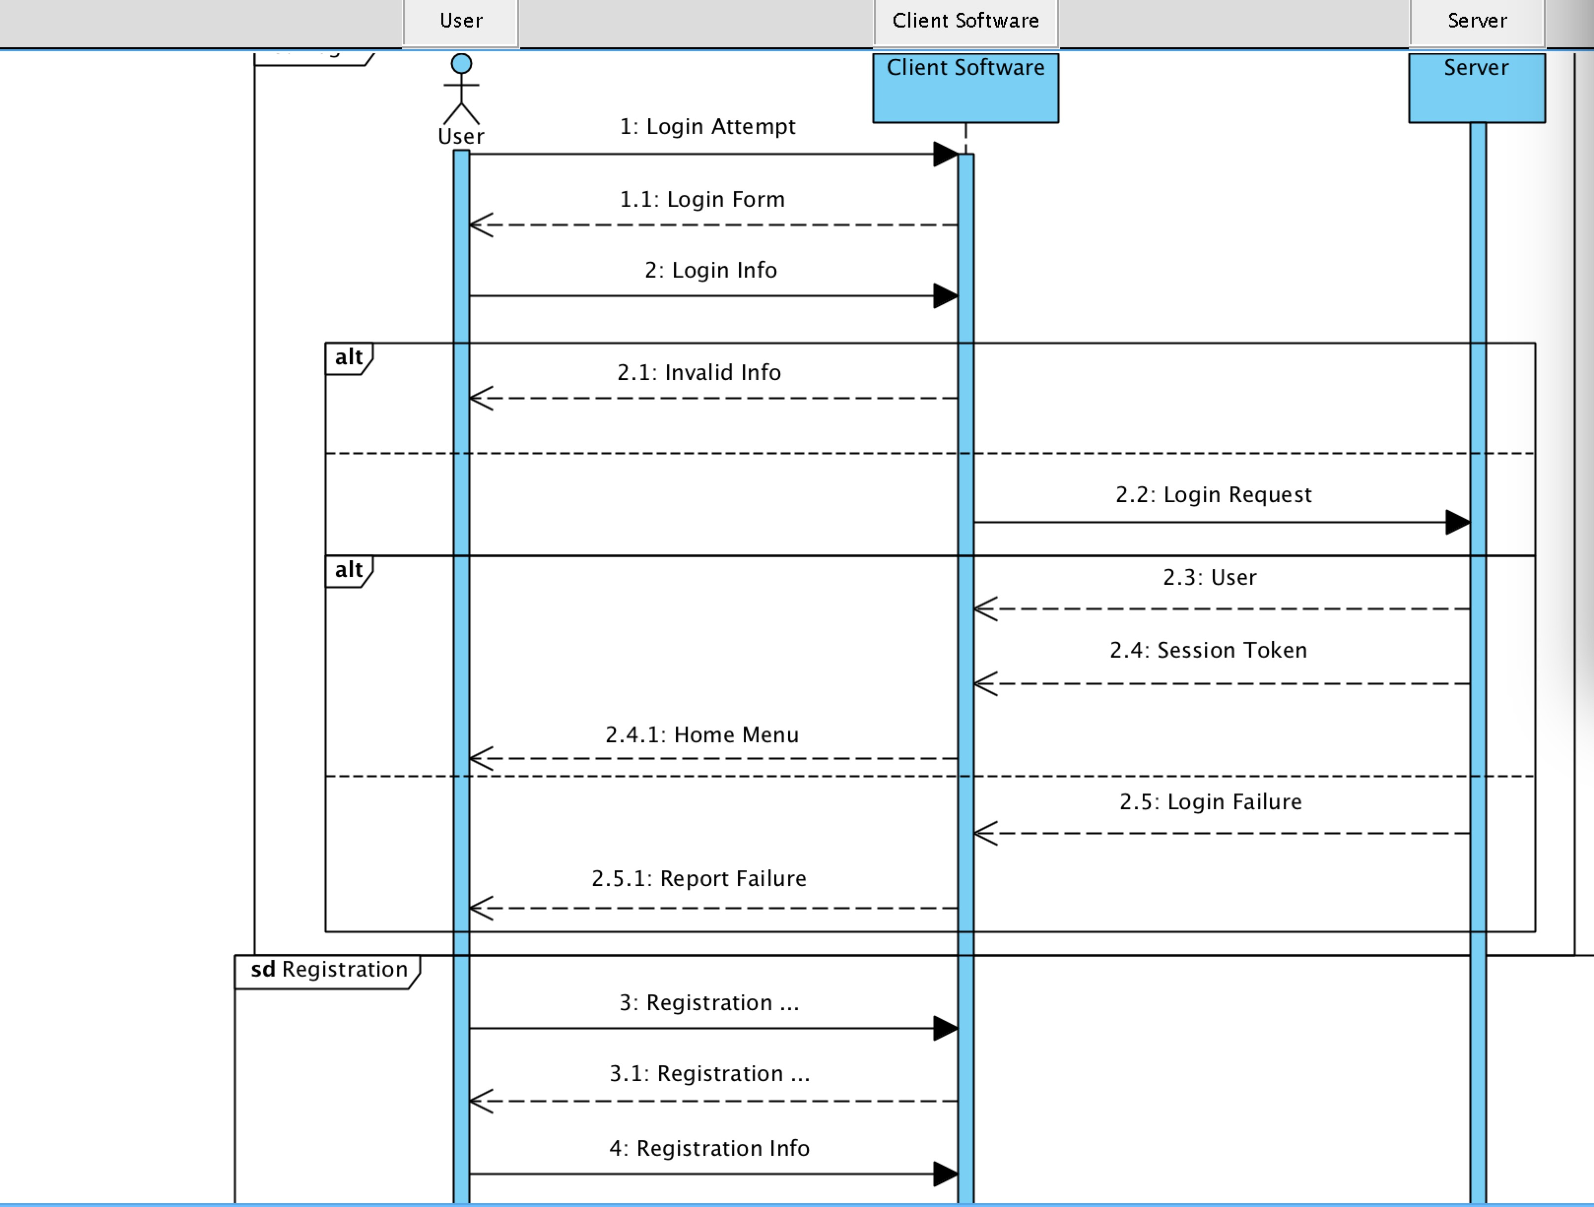

Slide 7
Domain Models

Slide 8
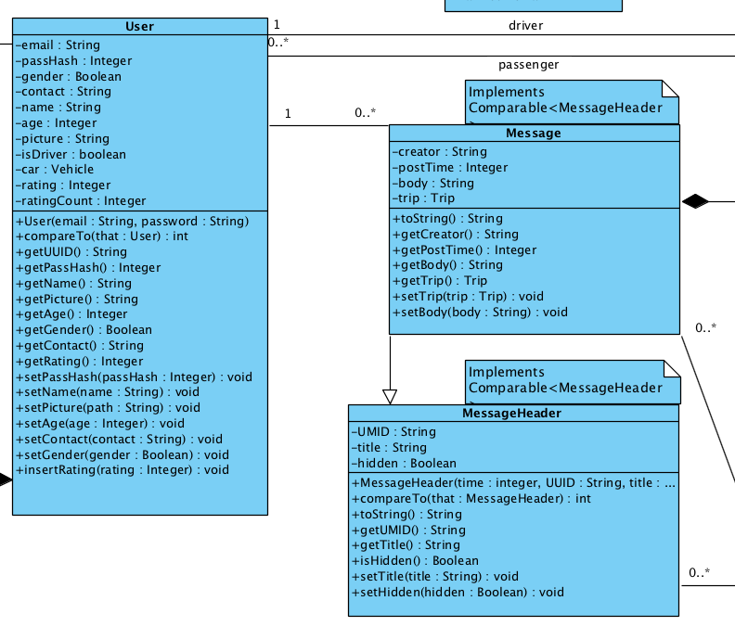

Slide 9
Use Case Diagram

Slide 10
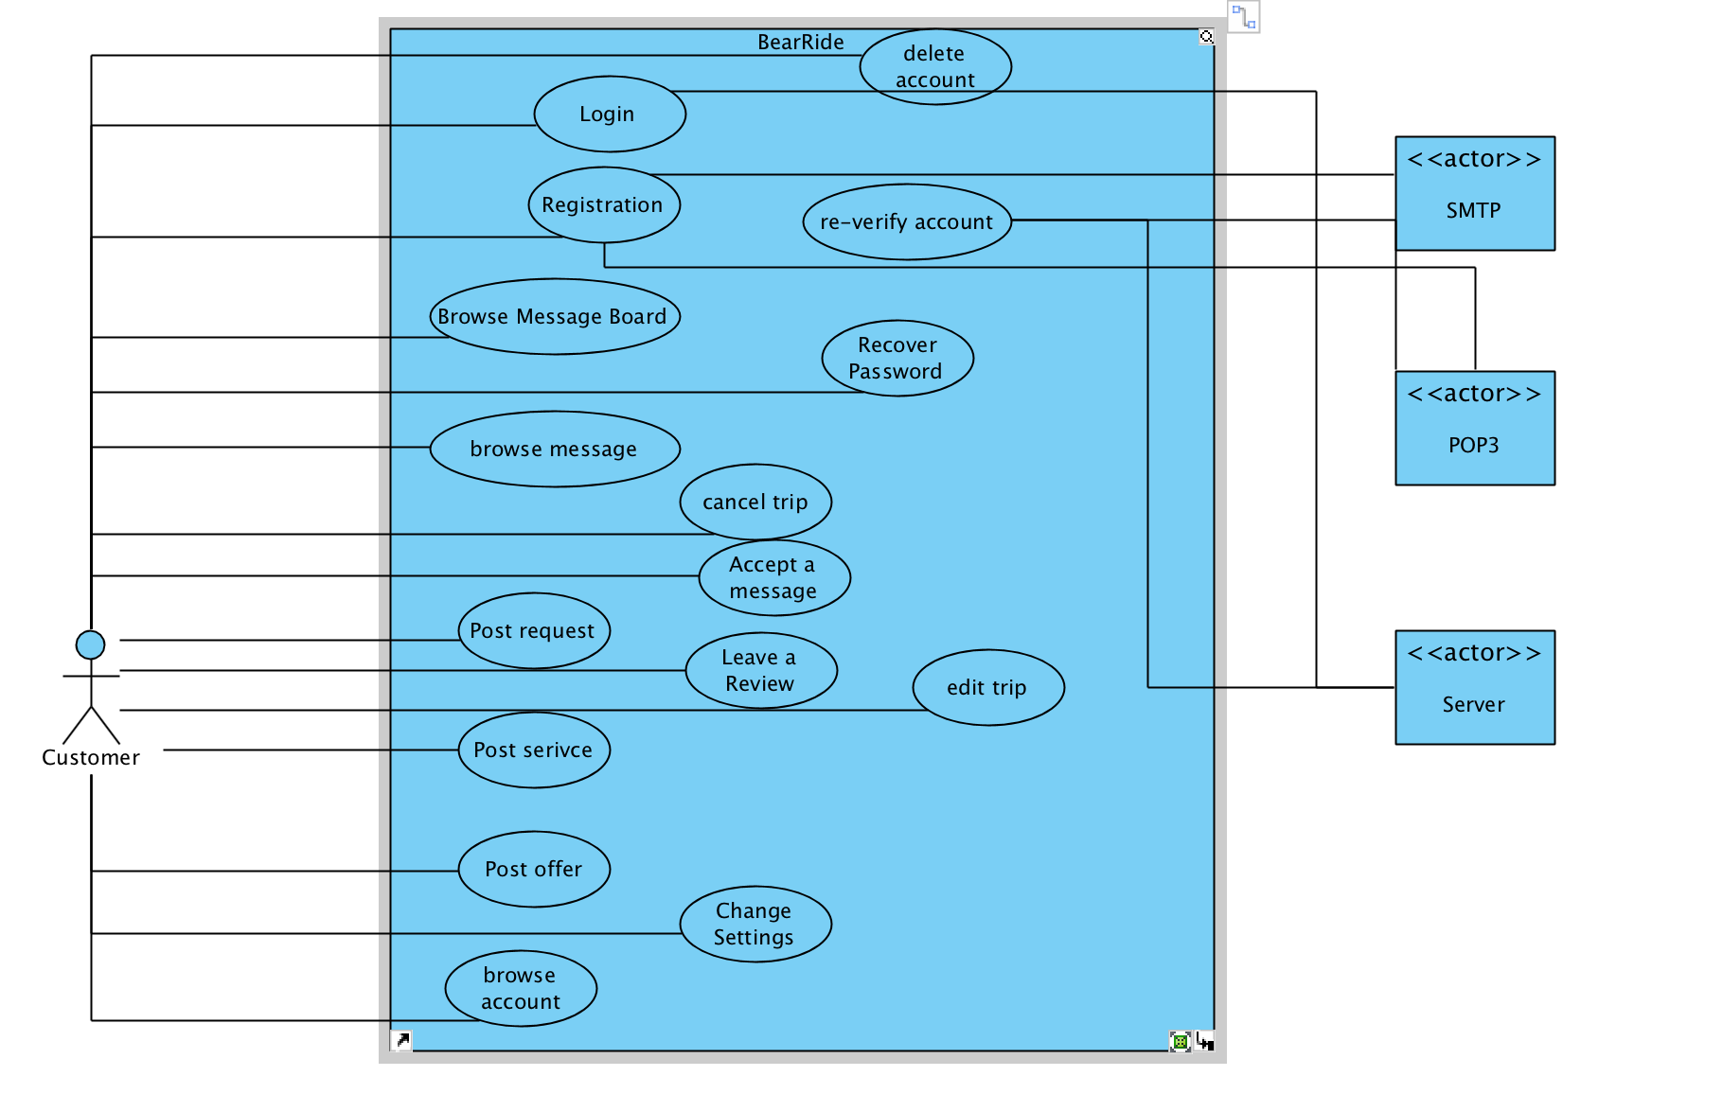

Slide 11
Wireframe

Slide 12
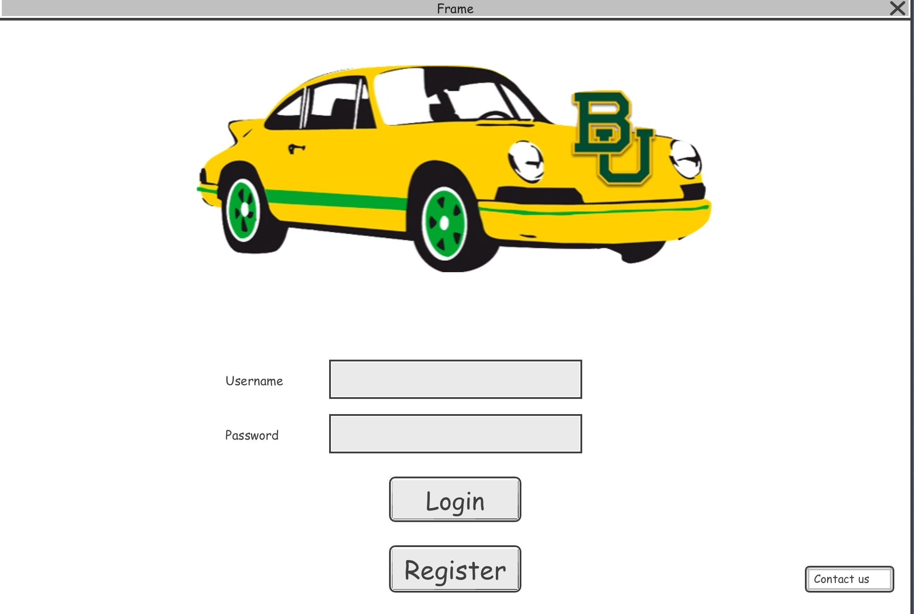

Slide 13
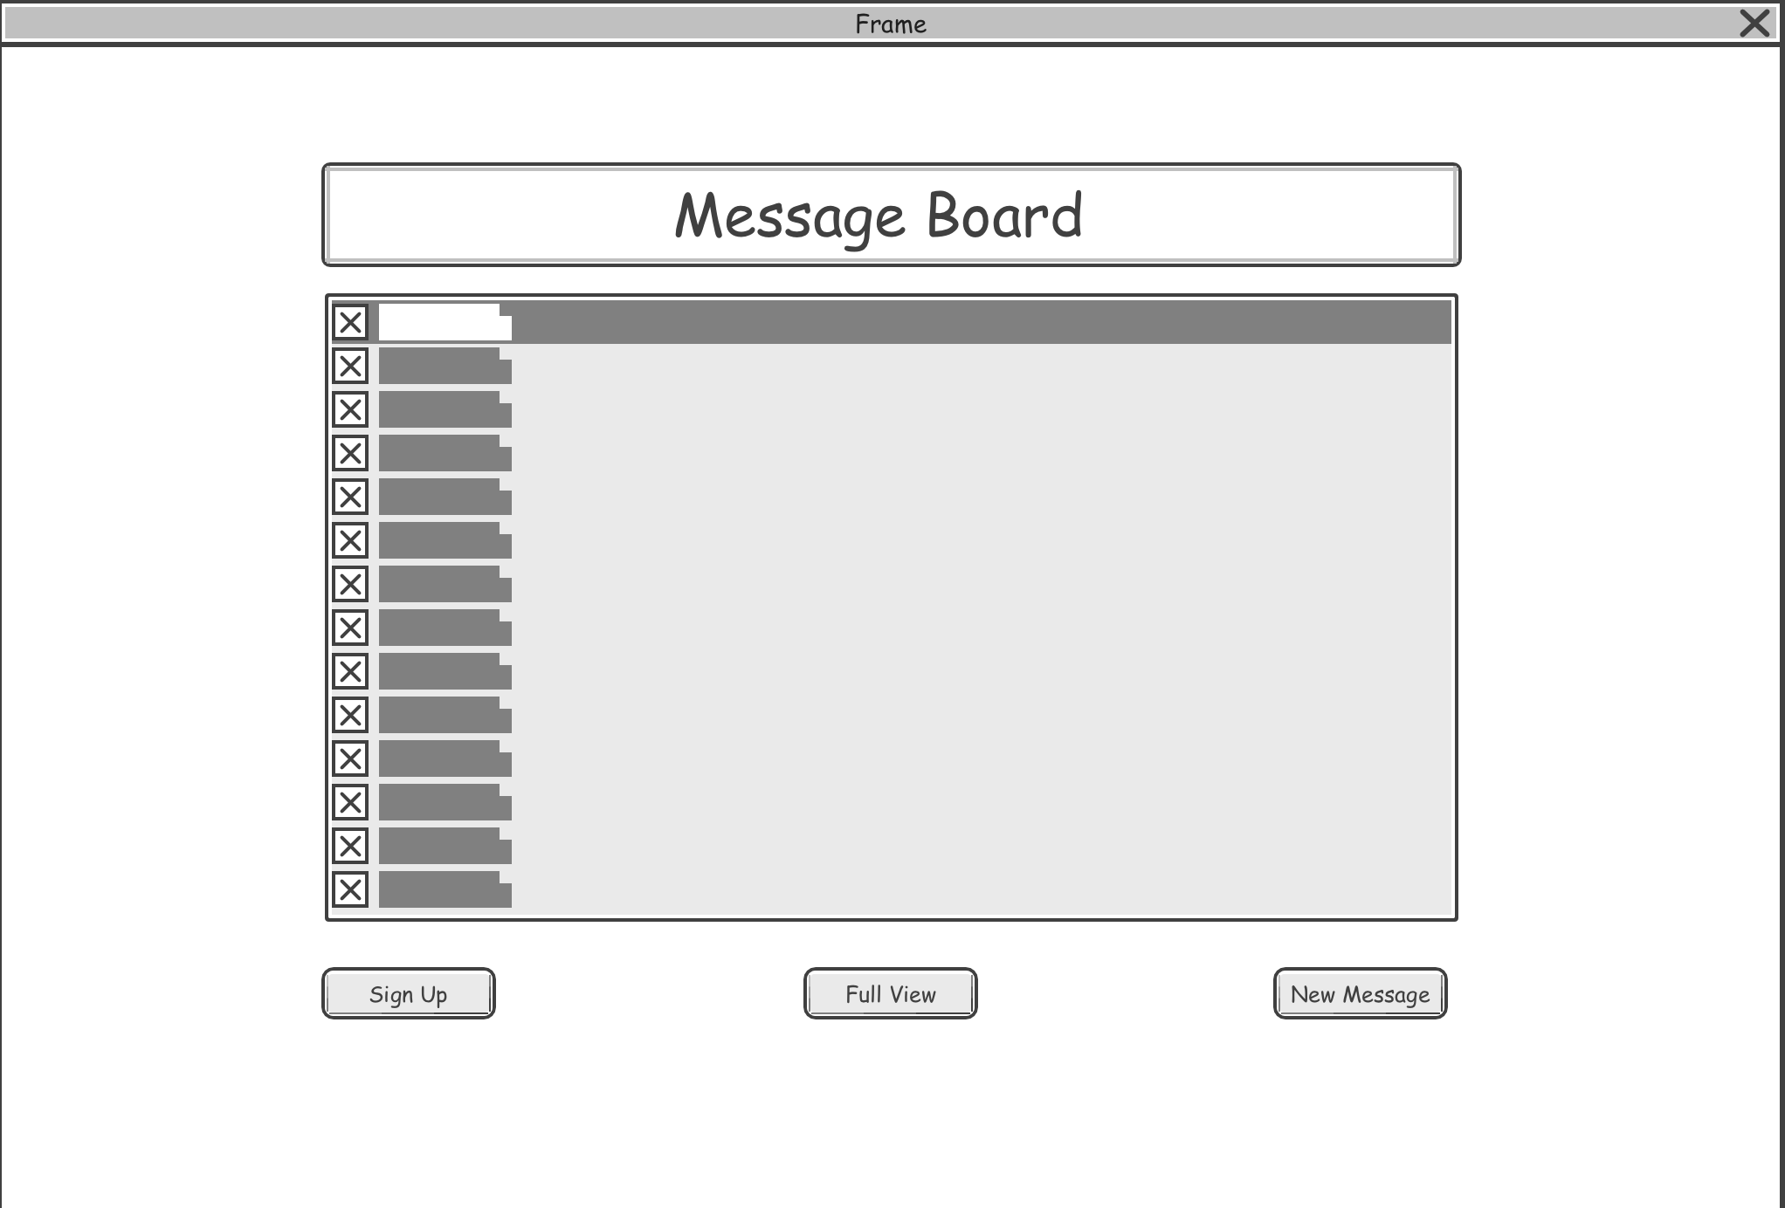

Slide 14
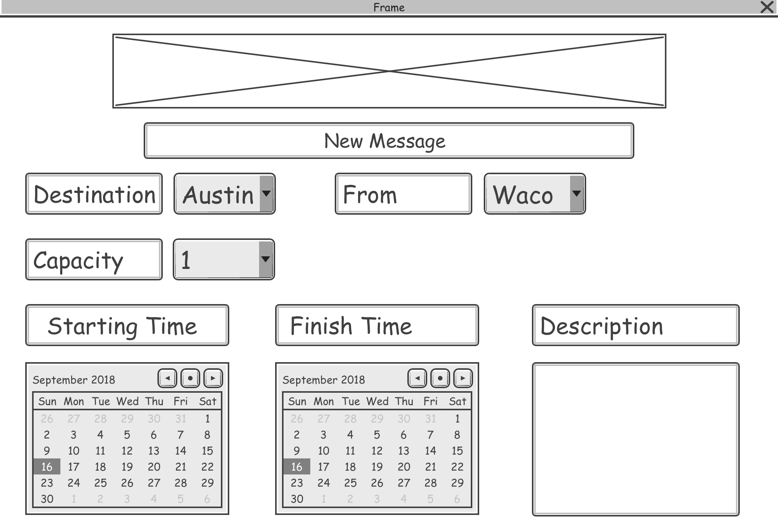

Slide 15
Thank you!
Check out for more:
http://cs.baylor.edu/~snavely/

